Slide 1
Smart Logistics Route For ONDC
Theme: E-Com
NG Team
Team member: N,Gopinth

Slide 2
ONDC Introduction
Open Network for Digital Commerce (ONDC) is open networks exchange of goods and services over digital or electronic networks
It standardize operations like cataloguing, inventory management, order management and order fulfilment
It eliminate platform-centric digital commerce model
ONDC would standardize operations, promote inclusion of local suppliers, drive efficiencies in logistics and lead to enhancement of value for consumers

Slide 3
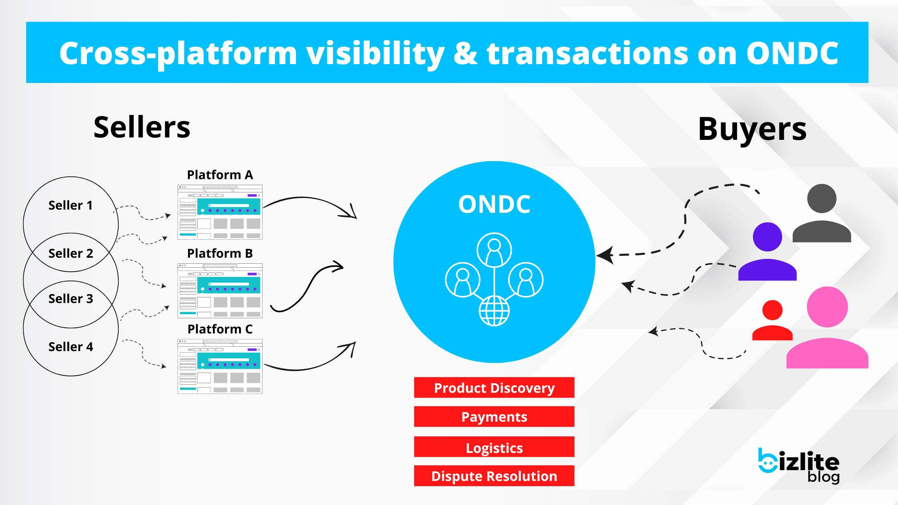
ONDC Workflow

Slide 4
Current Logistics Route
Platform-centric Logistics – Big E-Com player like flipkart own their own logistics. Like EKart
Logistics aggregator – Amazon like players tied up with multiple logistics based on location of the service.
Courier – Franchise based logistics network
Small individual seller provide home delivery to the surrounding region.

Slide 5
Smart Logistics Route
It Helps ONDC network, how efficiently it can use Logistics to deliver a product from seller to buyer.
L1
(Bangalore)
Commission: 2%
Operation time: 5hr
L1
(Bangalore)
Commission: 3%
Operation time: 2hr
Seller
(Delhi)
Buyer
(Chennai)
L1
(Hyderabad)
Commission: 4%
Operation time: 6hr
L1
(Mumbai)
Commission: 1%
Operation time: 10hr

Slide 6
Smart Logistics Route
Problem
Solution
Multiple logistics players
Different commissions
Different Operation Timings
Find Best route.
Cost efficient route.
Shortest route.
Use Travelling Salesman Problem (TSP)

Slide 7
Azure Services
Azure SQL Server-> for logistics data
Azure Web apps -> for request and response
Azure ML -> for core logic
Azure BI -> show best route

Slide 8
Architecture
Azure ML Pipeline
Python Transformation
Sql Transformation
Power BI
Azure Web app
Input Dataset
Output Dataset
Azure SQL Server

Slide 9
Demo

